Slide 1
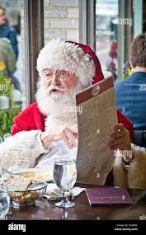
Jingle Bell Rock vs Jingle Bell Rock
By ME

Slide 2
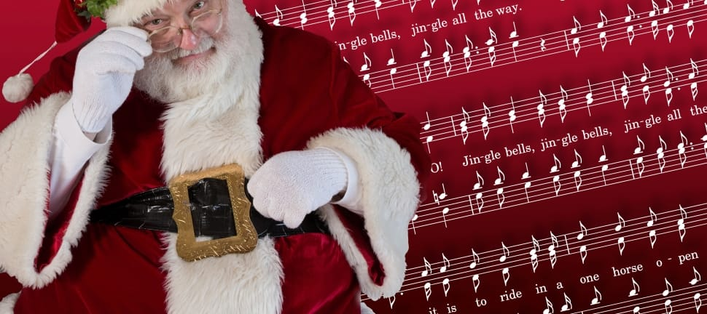
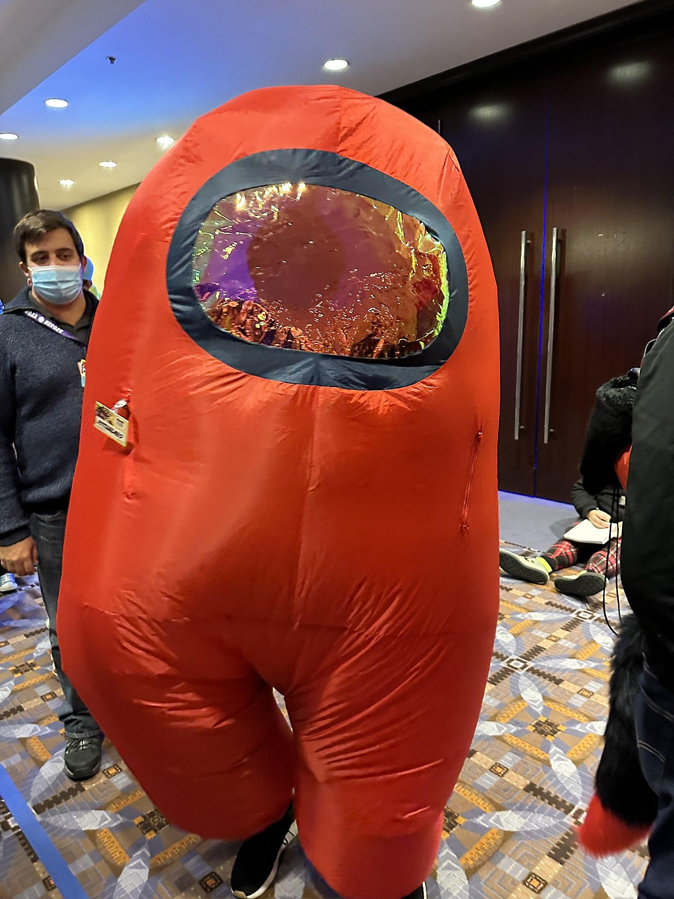
Similarity
Same Lyrics
Jolly
Full of Spirit
Great singing
Popular Song
Happiness
Both invoke the christmas spirit into people

Slide 3
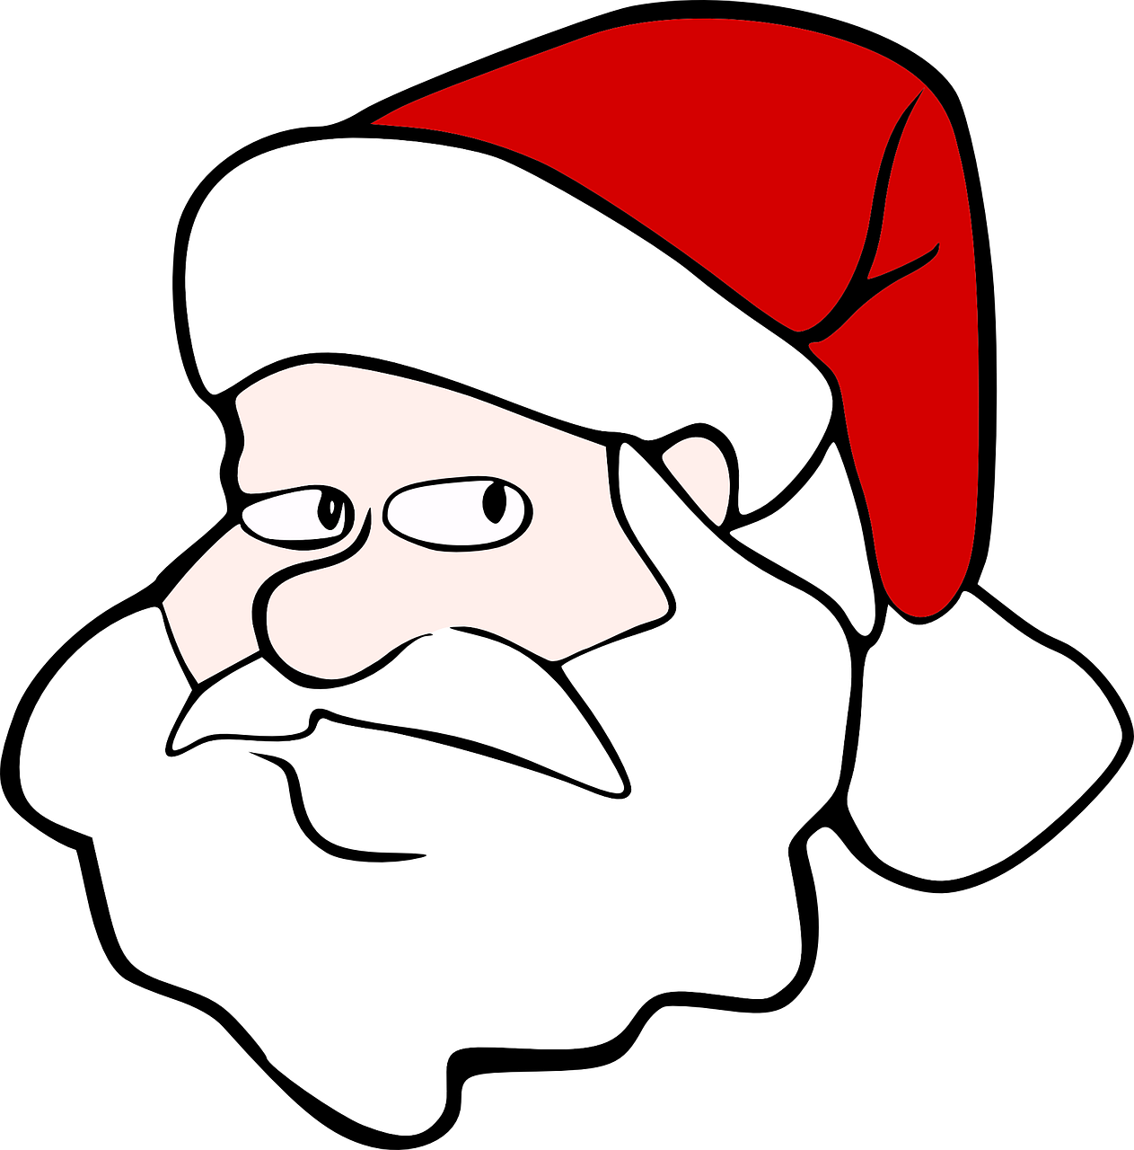

Differences
Different Singer
Different time
One came out 1957 and one came out in 2021
One has multiple singers in it and the other doesn't
Popularity
Theme
Rhythm

Slide 4
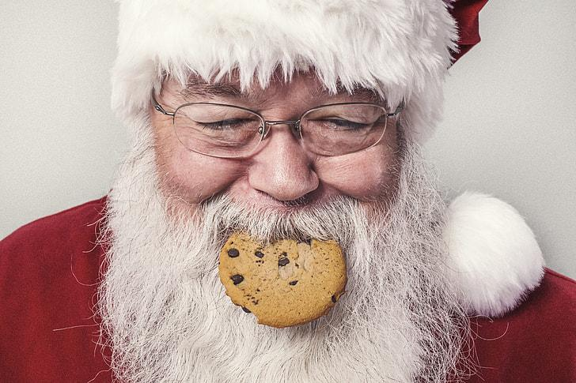

Songs by different artists
“Bobby Helms - Jingle Bell Rock (Lyrics) Youtube” https://www.youtube.com/watch?v=fyEAX7Cd3OE Published: November 14, 2022 Accessed: November 18, 2023
“Kelly Clarkson - Jingle Bell Rock (Official Audio) Youtube” https://www.youtube.com/watch?v=ddpoBHolcmo Published: October 15, 2021 Accessed: November 28, 2023 Author: Kelly Clarkson

Slide 5
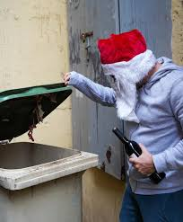
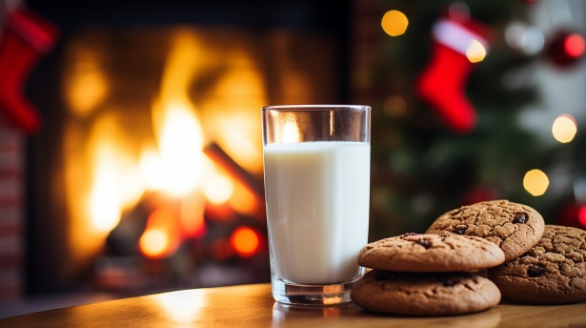
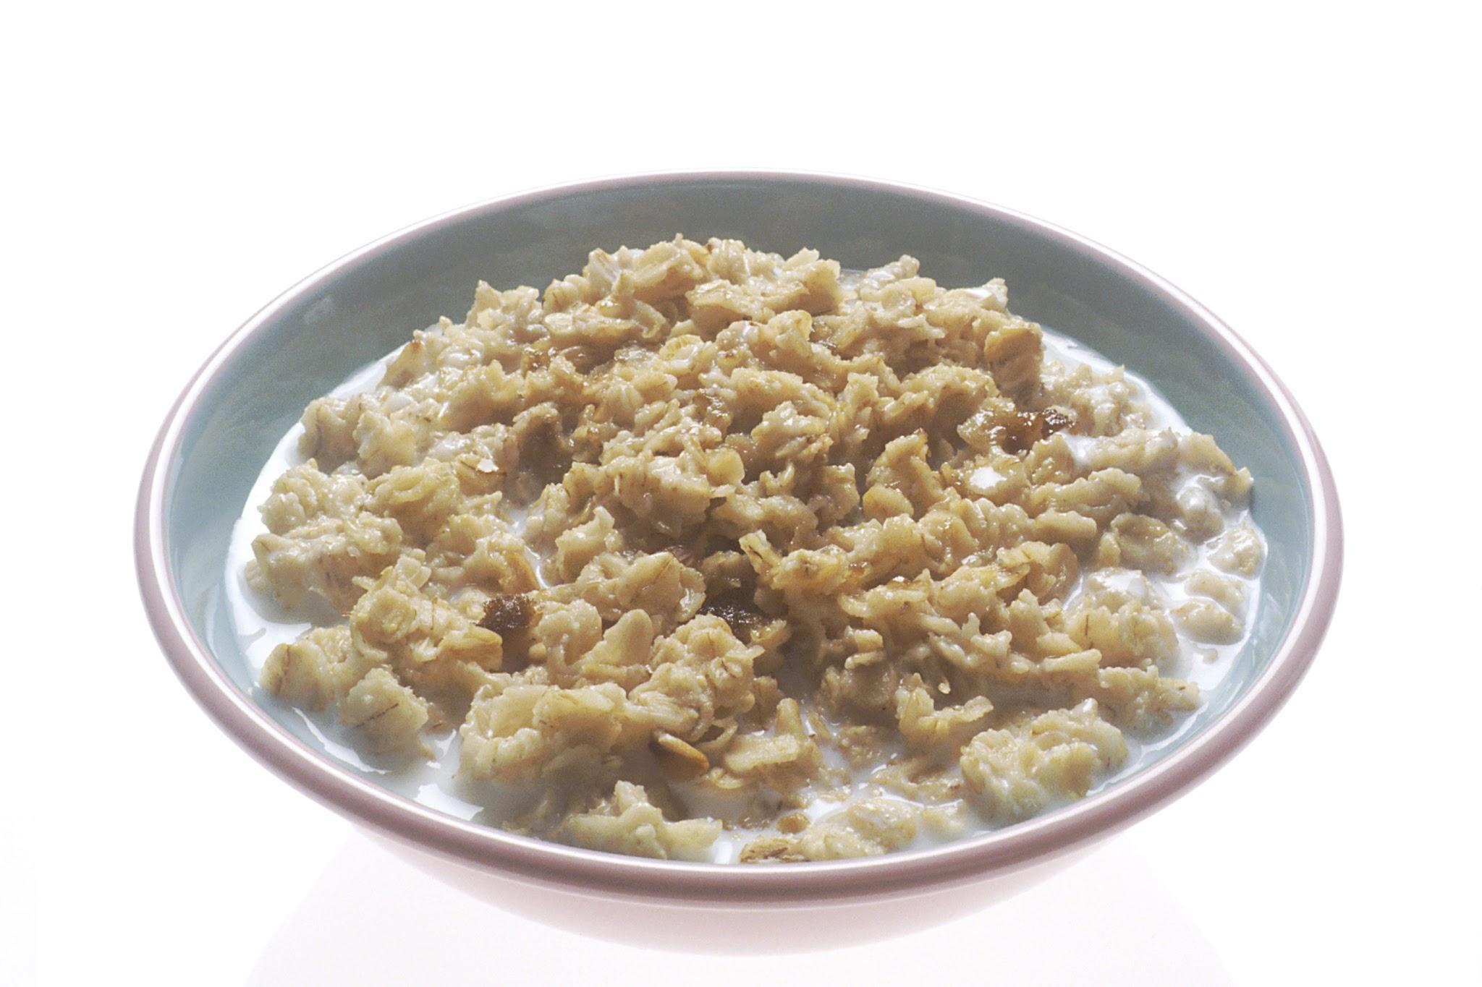
Sources
Google Image Search
Wikipedia
Youtube
This man likes porridge in the old trash can

Slide 6
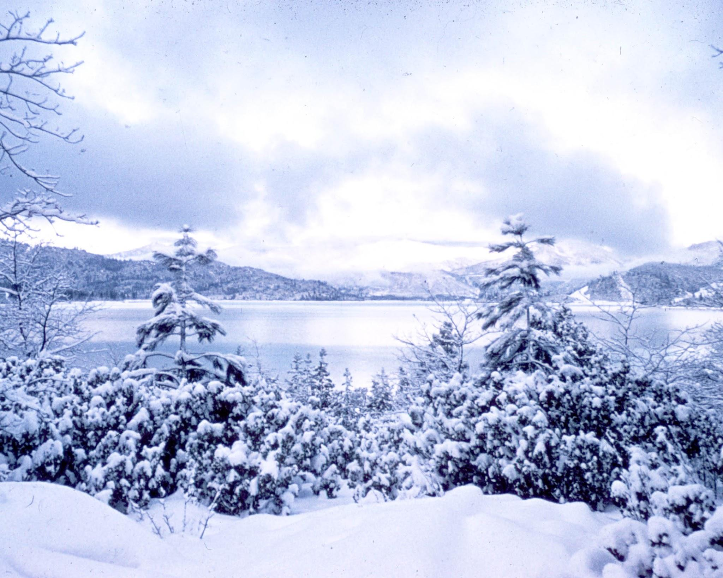
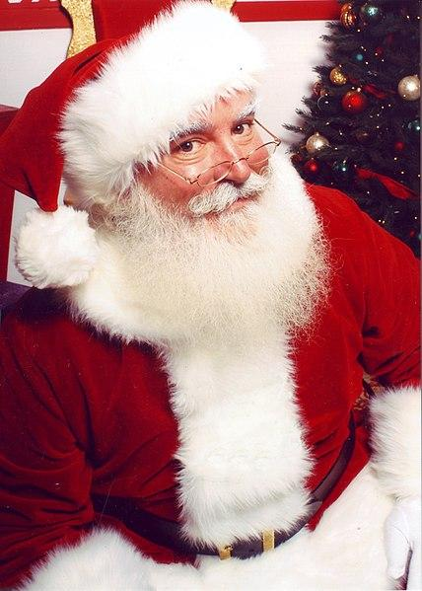

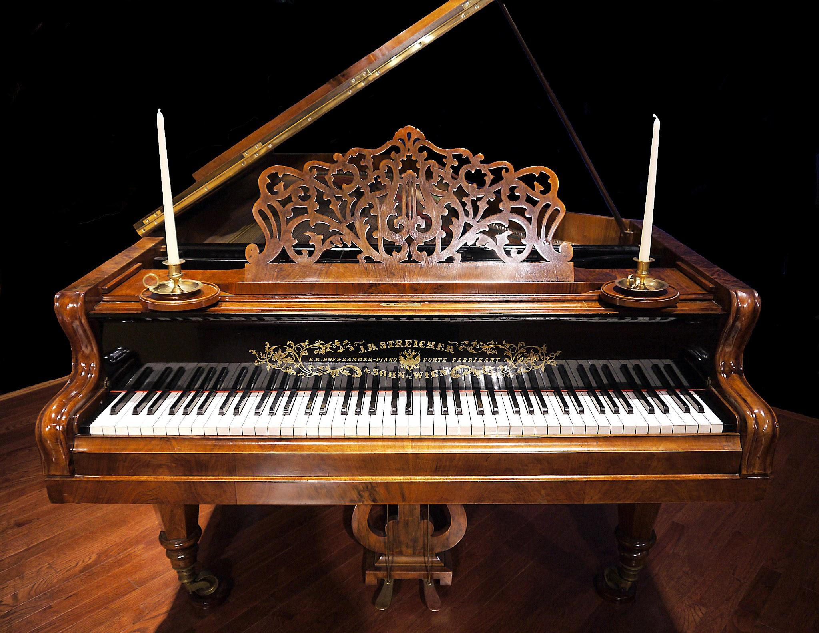
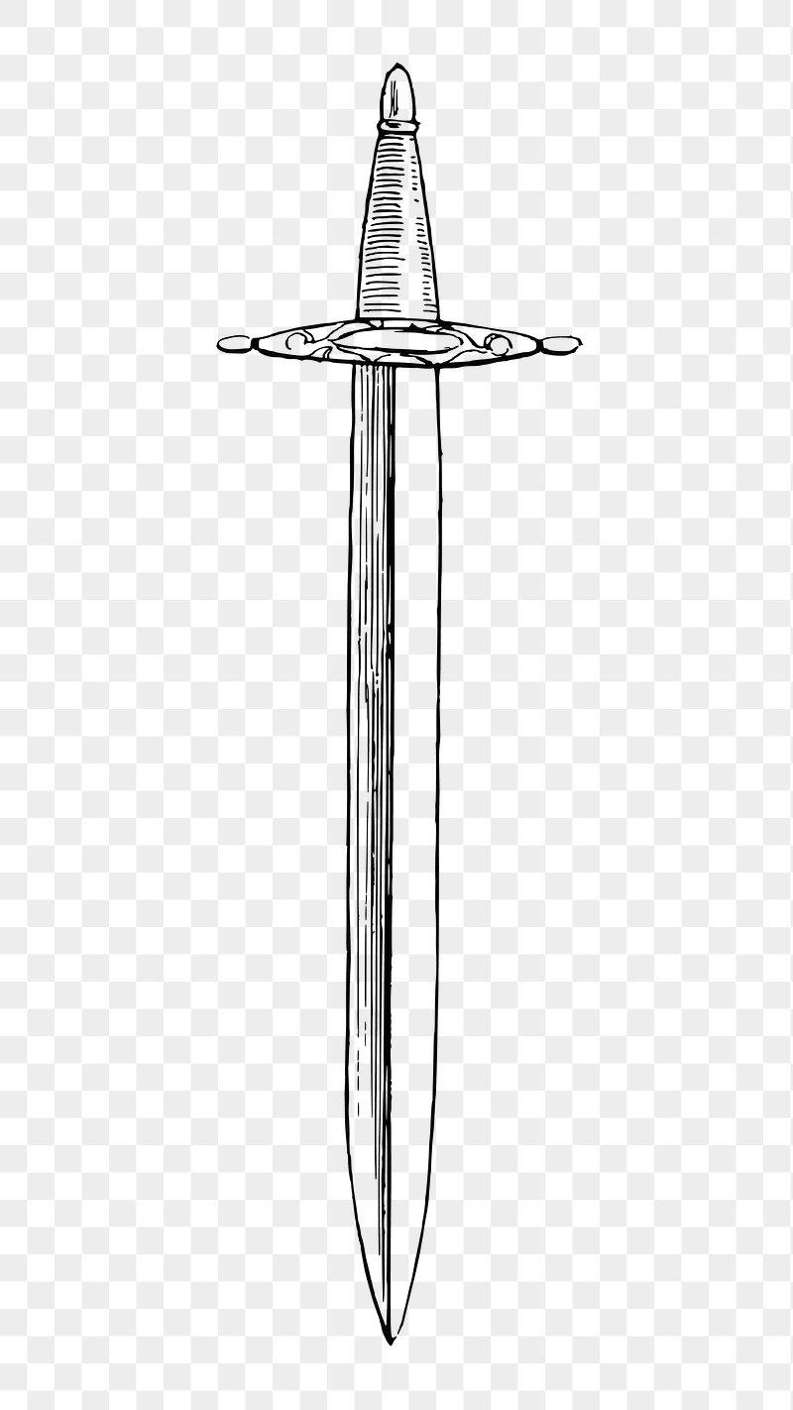
Children
No Piano for you Milin
I’m homeless Milin
child labor time your my first
victim!!
Not today
Sword time
No Santa pls

